Slide 1
HAVING CONFIDENCE IN YOUR HORSE’S PERFORMANCE

Slide 2
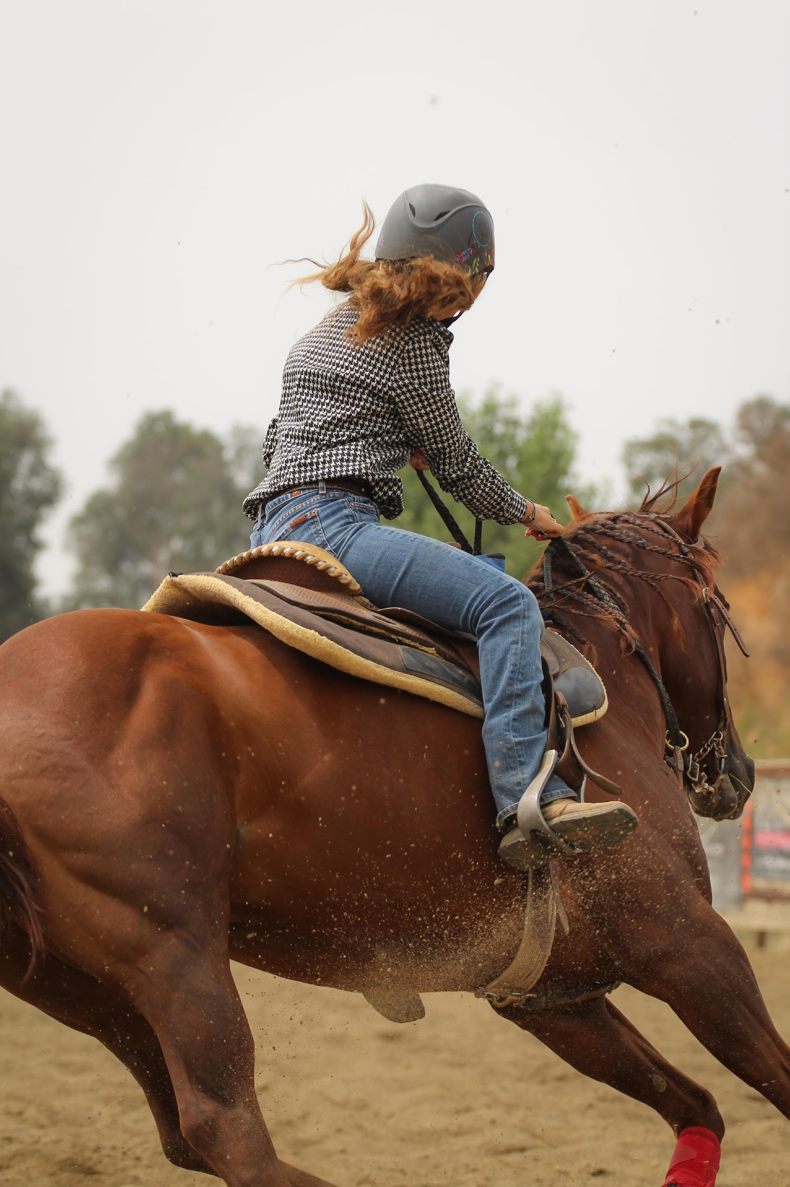
WHAT WOULD IT MEAN TO BE CONFIDENT IN YOUR HORSE?
Photo by Christine Benton on Unsplash
Notes:
Close your eyes and think of your next goal for your horse. What do you want your horse to be able to do that you don’t think it can do now?
What would it be like to tell someone that you are CONFIDENT your horse could do this?
When you hear that someone “looks confident,” you probably have an image in your mind of someone who looks sure of themselves.
But from experience, you probably know there’s a difference between trying to look confident and actually feeling confident.
Actually feeling confident isn’t about not projecting doubt or fear – it’s about feeling pretty sure that something’s going to go the way you want it.
And when you break it down, that actually comes from having the experience to know that what you try will be a success. And that doesn’t mean that you never failed – it actually means you failed and got beyond it!

Slide 3
ONLY WINNING MATTERS VS. MAKING PROGRESS
1ST GOAL
2ND GOAL
3RD GOAL
4TH GOAL
Notes:
Some people think that winning is the only point of competing, and if you don’t win, you didn’t get anything out of the competition.
However, the most reliable way to get better is to learn every time you compete or try. Look for progress, have a smaller goal. Maybe your horse finishes 15 seconds faster than last time.
Set your own goals and work on getting better. Move from one goal to the next.
As you accomplish these smaller goals – even if you don’t win the one overall prize – you see that you can improve.
This is what builds confidence.
This way of looking at things is also called the “growth mindset.” Let’s look at that a bit more.

Slide 4
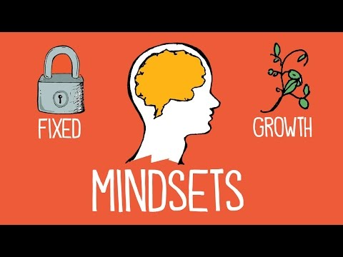
THE TWO MINDSETS
Graphic courtesy of Alliance College-Ready Public Schools
Notes:
Most of us are downright scared of failing. In fact, the fear or failure is probably the biggest obstacle to improving in almost any area of our life.
To get over that, we need to change our mindset from a fixed mindset to a growth mindset.
What is a mindset? It’s as term used to describe the way we think about ability and talent
Researchers have found there are 2 types of mindsets:
A fixed mindset refers to the belief that you can’t change your abilities. You were born with certain skills, and that’s just the way you are.
A growth mindset means that you believe you can improve at anything through practice.

Slide 5
GROWTH MINDSET AND YOUR BRAIN
Graphic courtesy of Alliance College-Ready Public Schools
Notes:
Let’s look a bit more at “growth mindset.” The name comes from the fact that, no matter how much you know now, you can always learn more and “grow your brain”
In fact, your brain is just like a muscle: if you train it, it can grow. It all comes down to practice

Slide 6
ADOPTING A GROWTH MINDSET
Fixed mindset | Growth Mindset
“I can’t do this.” | “Let me try a different strategy.”
“I made a mistake.” | “That mistake will help me learn and improve.”
“This is too hard. I give up.” | “I can do this! It’s just going to take some time and effort.”
“Plan A didn’t work.” | “Good thing the alphabet has 25 letters beyond A.”
Notes:
What does it mean, practically, to have a growth mindset?
It means that you don’t give up on learning when you encounter difficulties. If you don’t learn how to learn something new – driving a car, learning a new language, playing the guitar – easily, don’t say “I wasn’t born for this.” Instead, change your inner dialogue.
You’ll see some examples here:
From “I can’t do this.” to “Let me try a different strategy.”
From “I made a mistake.” to “That mistake will help me learn and improve.”
From “This is too hard. I give up.” to “I can do this! It’s just going to take some time and effort.”
From “Plan A didn’t work.” to “Good thing the alphabet has 25 letters beyond A.”

Slide 7
REMEMBER PAST SKILLS YOU’VE LEARNED
Notes:
This might all sound really hard. Can you really just change your mindset to do something that doesn’t seem possible?
Well, yes you can! Think of some of the things you’ve learned already in life. Reading is a really difficult skill. You learned it. There are probably lots of other really tricky things you already know: riding a bike, building something, etc. Think about these and how you pushed through to learn them.
Here’s an example of how you can apply lessons from past skills to future challenges.
After this video, you’ll do something similar to think about how to apply a past lesson to one involving your horse.

Slide 8
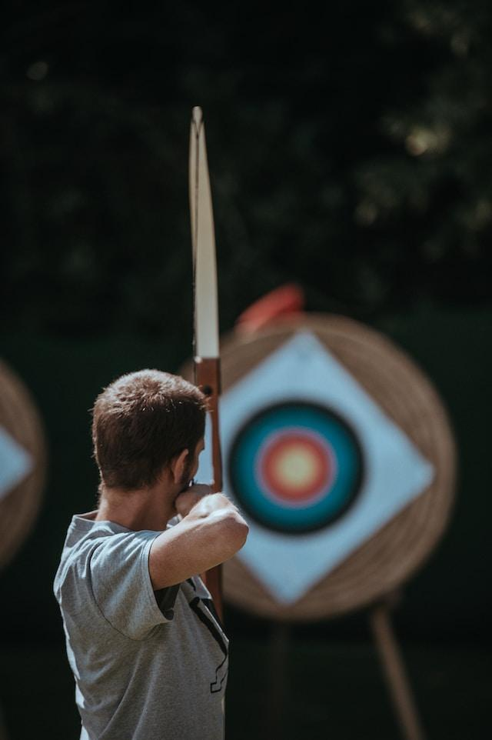
KEYS TO IMPROVING YOUR HORSE’S PERFORMANCE
PRACTICE
DON’T GIVE UP
PRACTICE EVEN MORE!
GET FEEDBACK FROM A TRUSTED MENTOR OR COACH
Photo by Annie Spratt on Unsplash
Notes:
What’s all this mean for improving your horse’s performance?
Basically, you just need to put in the time to practice – and don’t give up when you run into the inevitable struggle or downturn
Having a good mentor or coach also helps you learn from your mistakes faster – we’ll get to this in a moment

Slide 9
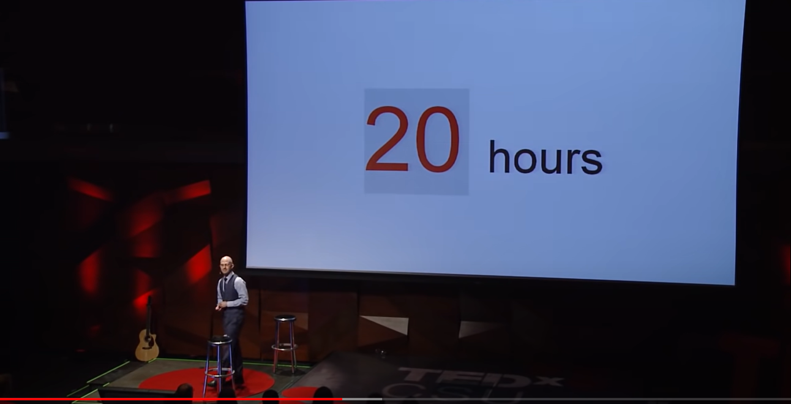
COMMIT TO AT LEAST 20 HOURS OF PRACTICE
From The first 20 hours -- how to learn anything | Josh Kaufman | TEDxCSU
Notes:
How much time do you need to practice?
Author Josh Kaufman says that with 20 hours, you can learn the basics of any skill
In a speech he gave called “The first 20 hours: how to learn anything,“ he stated that committing to a new skill for 20 hours ensures that you’ll make it past the inevitable setbacks and failures that will tempt you to quit
So when you are taking on a new challenge, try this: commit to keep going for at least 20 hours. If you can’t learn the basics in that time, you can stop. But the chances are high that you can do it with that time through the power of practice and learning from your failures

Slide 10
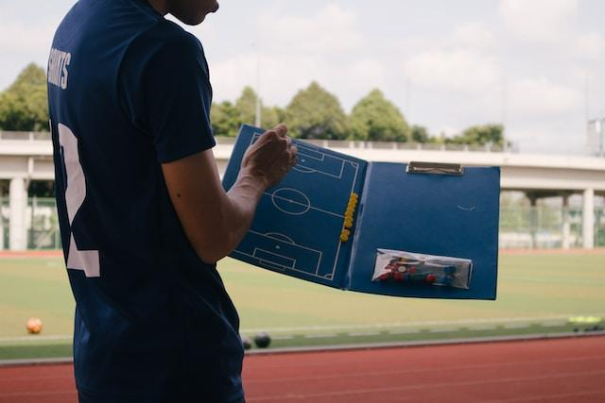
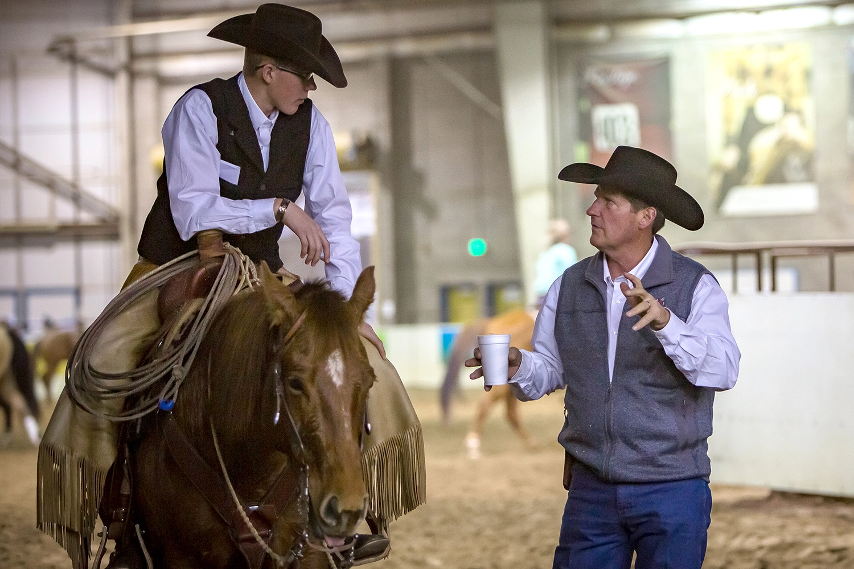
FINDING A MENTOR
Photo by Nguyen Thu Hoai on Unsplash
Photo by National Western Stock Show
Notes:
One important addition is that you get better faster when you have advice from experts. That’s why experts in performance recommend finding a mentor.
A good mentor won’t just give you advice – they will ask you questions to help you learn from your practice. They’ll ask things like:
What was the moment your horse was no longer doing what you wanted it to do? How did you react?
What differences did you notice in the times your horse did what you wanted and when they didn’t?
What did you learn from this round of practice?
To help you improve your performance, you’ll need to find a mentor. Think about which adults in your family, 4-H club, or community could help you. Make a list of these people and put them in order of who you want to ask first.

Slide 11
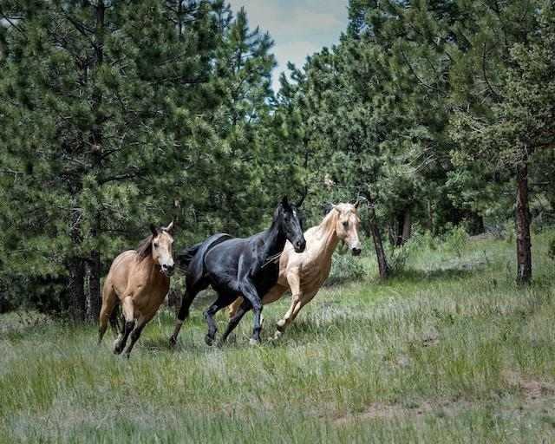
NEXT STEPS
Photo by Gene Devine on Unsplash
Notes:
It’s time to put this into practice. Use the “Setting a Performance Goal for Your Horse” worksheet to map out your plan for taking your horse to the next level.
It also asks you to find a mentor. Once you’ve identified someone, ask one of your 4-H leaders to help you reach out and start working with them.
Remember – if you put in the time and don’t give up, you – and your horse – can and will be able to do this.

