Slide 1
MENTAL WELLNESS Information for Parents Maria Torres, LCSW Clinical Consultant December 2022

Slide 2
OBJECTIVES
Discuss Prevalence of Adolescent Mental Illness
Learn Some of the Symptoms and Challenges Adolescents Deal With
Explore Approaches on how to discuss or bring up the issue
Resources

Slide 3
Introduction
Education
Work History
Experience
Passion

Slide 4
DISCLAIMER
This presentation is for educational and awareness purpose only. This is not to diagnose or offer mental health treatment.
I will however provide resources later in the presentation on how to seek help if assistance is needed.

Slide 5
THE COVID-19 PANDEMIC BROUGHT…
SHELTER IN PLACE
SOCIAL DISTANCING
DISRUPTION IN ROUTINES
UNCERTANTY
CHANGES
WORRY/FEAR/DANGER
“NEW NORMAL”
ISOLATION
LONELINESS
CHAOS
LOSSES
IMPACT ON MENTAL HEALTH

Slide 6
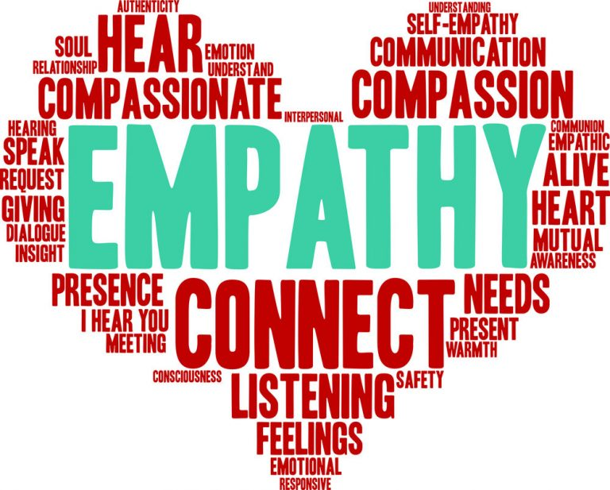
IMPACT ON ADOLECENTS
Social Skills/Connections
Sense of Identity
Empathy
Development
Notes:
Specially important because
COVID-19 social distancing requirements have a different emotional impact on them than on adults.

Slide 7
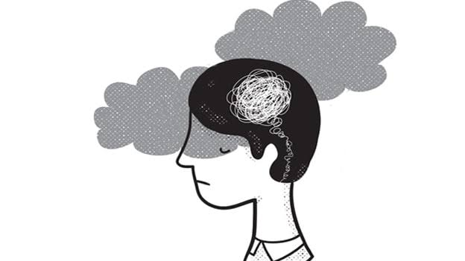
What is Mental Illness:
According to the American Psychiatric Association
“Mental illnesses are health conditions involving changes in emotion, thinking or behavior (or a combination of these). Mental illnesses can be associated with distress and/or problems functioning in social, work or family activities.”
Notes:
Mental Health...involves effective functioning in daily activities resulting in:
Productive activities (such as in work, school or caregiving).
Healthy relationships.
Ability to adapt to change and cope with adversity.

Slide 8
Why Youth Mental Health Matters
“Mental health challenges are the leading cause of disability and poor life outcomes in young people. Unfortunately, in recent years, we’ve seen significant increases in certain mental health disorders in youth, including depression, anxiety, and suicidal ideation.”
—Dr. Vivek H. Murthy Surgeon General of the United States
https://www.hhs.gov/surgeongeneral/priorities/youth-mental-health/index.html#explore

Slide 9
The Numbers
More than a third (37%) of high school students reported they experienced poor mental health during the COVID-19 pandemic
44% reported they persistently felt sad or hopeless during the past year
More than half (55%) reported they experienced emotional abuse
Notes:
This info came from the Adolescent Behaviors and Experiences Survey (ABES), first nationally representative survey of public- and private-school high school students to assess the well-being of U.S. youth during the COVID-19 pandemic.
Students were survey during January – June 2021.

Slide 10
ANXIETY
Emotional symptoms:
Physical symptoms:
Feelings of apprehension or dread
Feeling tense or jumpy
Restlessness or irritability
Anticipating the worst and being watchful for signs of danger
Pounding or racing heart and shortness of breath
Sweating, tremors and twitches
Headaches, fatigue and insomnia
Upset stomach, frequent urination or diarrhea

Slide 11
DEPRESSION SYMPTOMS:
Changes in sleep
Changes in appetite
Lack of concentration
Loss of energy
Lack of interest in activities
Hopelessness or guilty thoughts
Changes in movement (less activity or agitation)
Physical aches and pains
Suicidal thoughts
NAMI

Slide 12
What Is Self-Harm?
Self-harm or self-injury means hurting yourself on purpose. Any time someone deliberately hurts themself is classified as self-harm.
Hurting yourself—or thinking about hurting yourself—is a sign of emotional distress.
These uncomfortable emotions may grow more intense if a person continues to use self-harm as a coping mechanism. Learning other ways to tolerate the mental pain will make you stronger in the long term
Notes:
NAMI
National Alliance on Mental Illness

Slide 13
Warning Signs
It can be tough to tell if troubling behavior in a child is just part of growing up or a problem that should be discussed with a health professional. But if there are behavioral signs and symptoms that last weeks or months, and if these issues interfere with the child’s daily life at home and at school, or with friends, you should contact a health professional.

Slide 14
Older children and adolescents may benefit from an evaluation if they:
Have lost interest in things that they used to enjoy
Have low energy
Sleep too much or too little, or seem sleepy throughout the day
Are spending more and more time alone, and avoid social activities with friends or family
Diet or exercise excessively, or fear gaining weight
Engage in self-harm behaviors (such as cutting or burning their skin)
Smoke, drink alcohol, or use drugs
Engage in risky or destructive behavior alone or with friends
Have thoughts of suicide
Have periods of highly elevated energy and activity, and require much less sleep than usual
Say that they think someone is trying to control their mind or that they hear things that other people cannot hear.
https://www.nimh.nih.gov/health/publications/children-and-mental-health#:~:text=Older%20children%20and%20adolescents%20may,seem%20sleepy%20throughout%20the%20day

Slide 15
WHAT CAN PARENTS DO:
Parents should not only listen to what their children are telling them, they should also note any behaviors that may signal that there are issues (irritability, crying, aggression, isolation).
Parents who notice significant changes in their child’s behaviors should start with an open, non-judgmental conversation and reassure your child that help is available.
Parents can provide: love, patience, and positive examples. Parents can provide this by checking in with their teens, listening more, and acknowledging that even grownups get overwhelmed. Maintaining connections with others and sharing their thoughts is often the best way to diffuse pent-up feelings. By being open and honest, they can teach resilience to their children.
https://hub.jhu.edu/2020/05/11/covid-19-and-adolescents/
Notes:
The students need to feel Emotionally safe to open up and talk
They can have difficulty expression how they are feeling
They fear adults might not understand them, wont believe them or not take them seriously

Slide 16
What parents and families can do:
Communicate openly and honestly, including about their values.
Supervise their adolescent to facilitate healthy decision-making.
Spend time with their adolescent enjoying shared activities.
Become engaged in school activities and help with homework.
Volunteer at their adolescent’s school.
Communicate regularly with teachers and administrators.
https://www.cdc.gov/healthyyouth/mental-health/index.htm

Slide 17
How often should I check in with my child about their mental health?
When it comes to our children’s mental health, we can’t see their internal states.
So, it’s important to check in regularly with them to help you recognize when they need extra support.
If you notice concerning changes in your child, let them know you’re there and ready to support them however they need.
Don’t be afraid to ask for help by talking to a doctor, nurse, or other professional or looking into other available resources in your community such as school.
https://www.hhs.gov/surgeongeneral/priorities/youth-mental-health/index.html

Slide 18
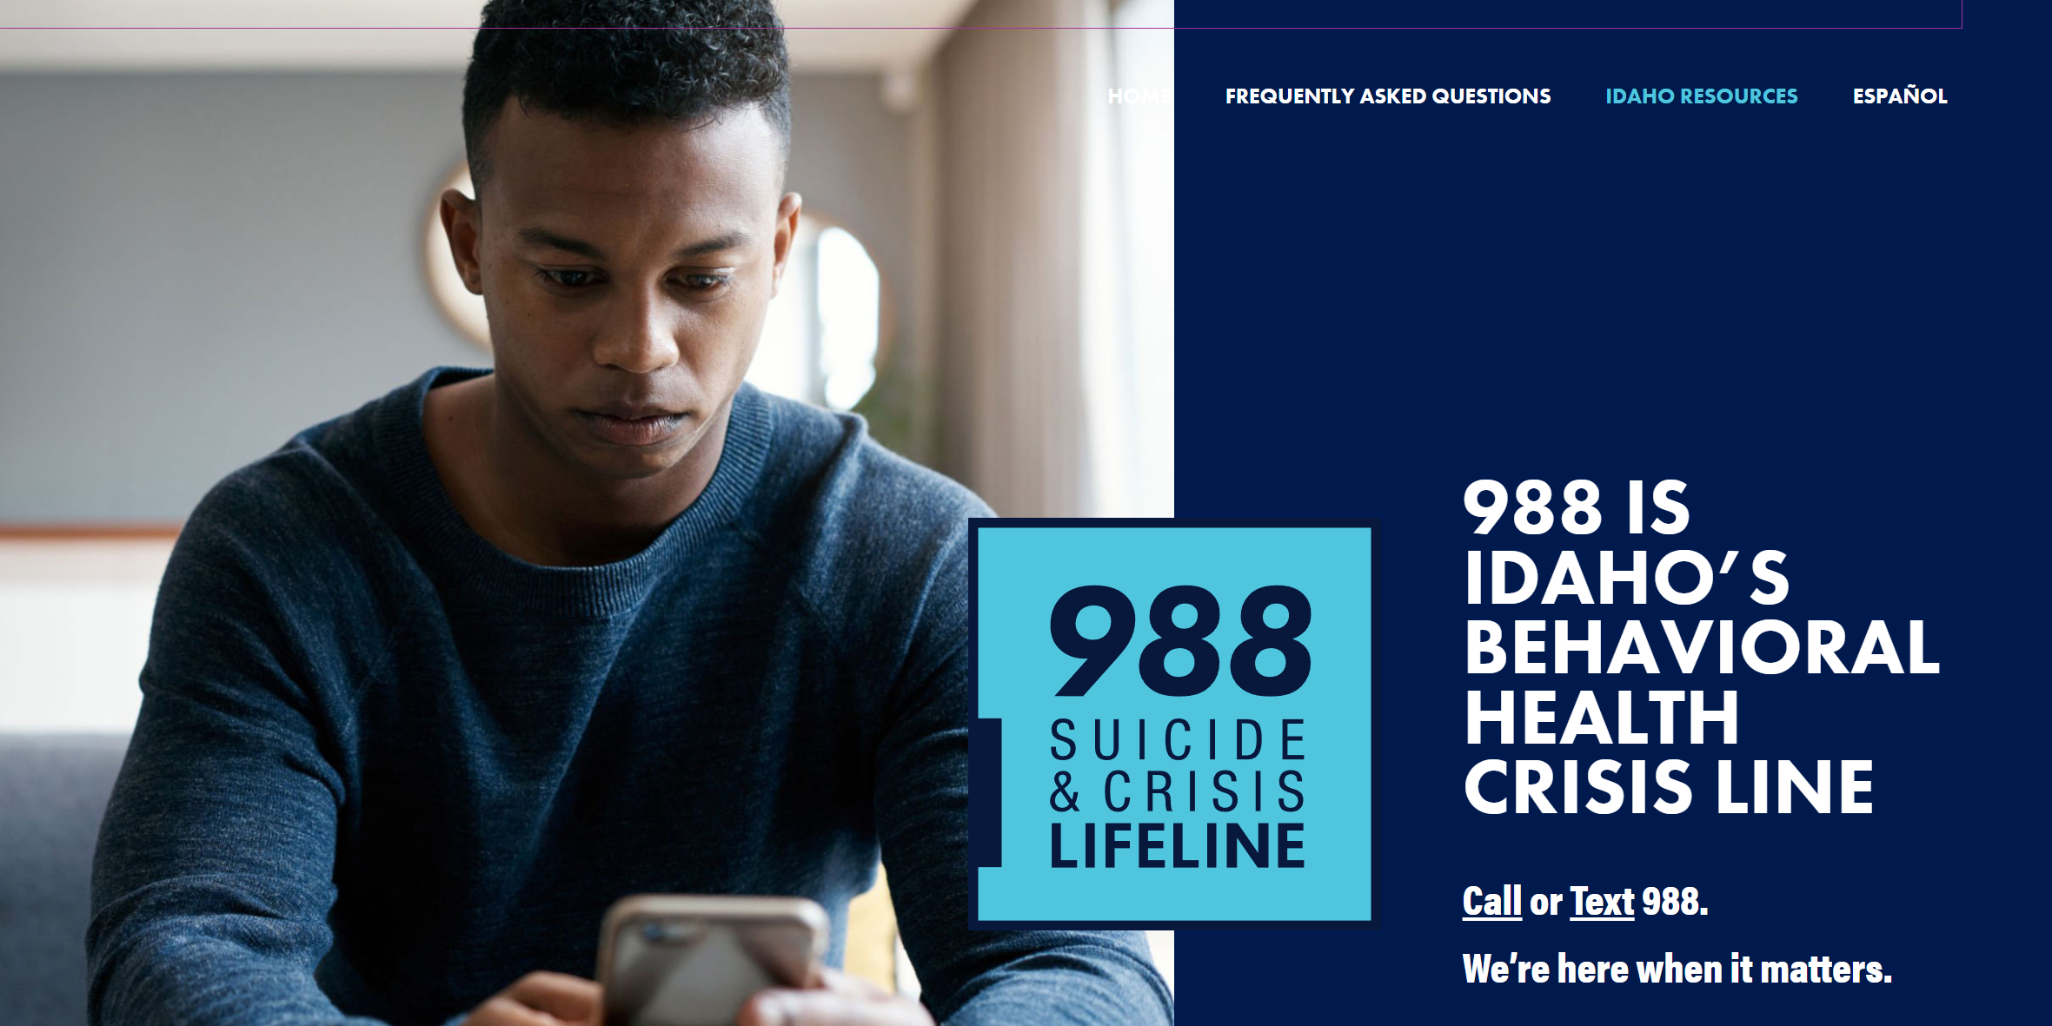
It may be helpful for teens to save several emergency numbers
The ability to get immediate help for themselves or for a friend can make a difference.
The phone number for a trusted friend or relative
The non-emergency number for the local police department
The Crisis Text Line: 741741
988 Suicide & Crisis Lifeline: 988.
https://www.nimh.nih.gov/health/topics/child-and-adolescent-mental-health

Slide 19
RESOURCES
National Alliance on Mental Illness QR Barcodes?
https://nami.org/About-Mental-Illness
National Institute of Mental Health
https://www.nimh.nih.gov/
American Psychiatric Association
https://www.psychiatry.org/Patients-Families/Warning-Signs-of-Mental-Illness
John Hopkins University
https://hub.jhu.edu/2020/05/11/covid-19-and-adolescents/
The Trevor Project
https://www.thetrevorproject.org/
Notes:
More info and education,
Resources
The trevor project LGBTQ

Slide 20
RESOURCES CONT.
Clinics near you…
Family Health Services
https://www.fhsid.org/locations/
Cornerstone Whole Healthcare Organization
https://www.c-who.org/partner-resources-and-tools/
Notes:
Integration
Some have mental health specialist such as

Slide 21
Linda will add info about grant
Notes:
This is the information about the grant that made it possible for us to bring this information to you

Slide 22
References
https://www.childrenscolorado.org/community/community-health/mental-health/mental-health-toolkit/
https://hub.jhu.edu/2020/05/11/covid-19-and-adolescents/
https://www.cdc.gov/media/releases/2022/p0331-youth-mental-health-covid-19.html
https://www.cdc.gov/healthyyouth/mental-health/index.htm
https://www.nimh.nih.gov/health/topics/child-and-adolescent-mental-health
https://nami.org/About-Mental-Illness/Mental-Health-Conditions/Depression
https://www.hhs.gov/surgeongeneral/priorities/youth-mental-health/index.html#explore
https://www.thetrevorproject.org/
http://sf-act.com/resources.php

