Slide 1
TAKE CHARGE OF YOUR HEALTH

Slide 2
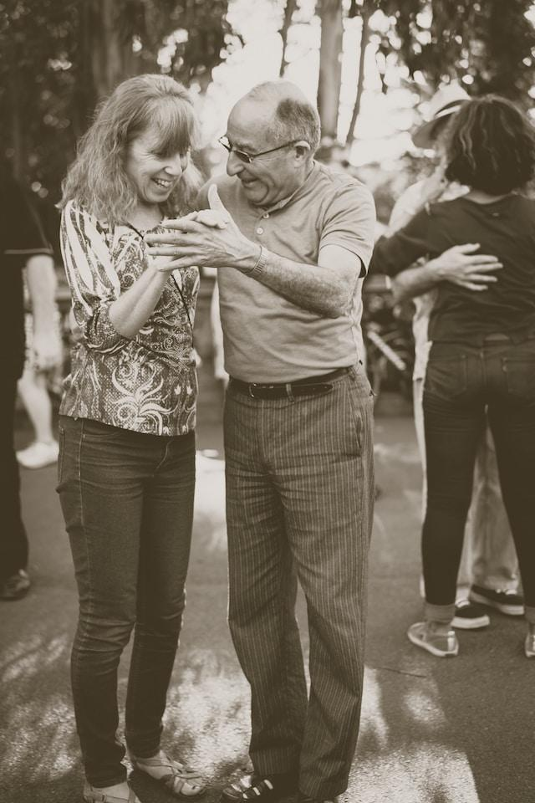
WHAT IS HEALTH?
Photo by Boise State Athletics
Photo by John Moeses Bauan on Unsplash
Notes:
When we hear the word “healthy,” we may picture an NFL athlete, or Olympic champion
But you don’t need to be an incredible athlete to be considered “healthy”
Healthy just means physical, mental and social wellness. It means feeling good physically and mentally to do the things you like.
Anyone can be healthy if they develop good habits - things they do consistently each day and week.

Slide 3
WHY SHOULD I CARE ABOUT MY HEALTH?
Taking charge of your health now can allow you to have enough energy to to enjoy horseback riding as you age and go through life.
Riding and enjoying horses requires you to have enough energy. Examples of that include:
1. The energy to take care of your horse
2. The energy to improve your horsemanship as you set more goals to improve your horseback riding
3. The energy to earn enough income or own a horse related business to somehow pay for your horses
Photo by Christine Benton on Unsplash
Notes:
The more you take care of your health, the longer you’ll have to enjoy the things you like in life
Think of all the things you enjoy doing now. The longer you are healthy, the more time you’ll be able to keep doing these things.
This girl loves riding her horse. If she stays healthy, she can keep riding her horse for decades into the future.
Staying healthy also means you are more likely to have the energy and focus to achieve your dreams.
Say that this girl wants to be a horse trainer someday. To do that, she’ll need to stay healthy so she can take care of her horses, have energy to train horses and riders, and put in the time to start her own business.

Slide 4
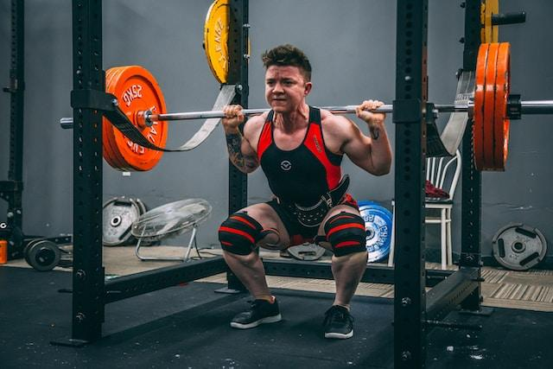
ISN’T IT HARD TO BE HEALTHY?
Photo by Alora Griffiths on Unsplash
Notes:
Yes and no. You don’t need to do anything extreme like keep to a strict diet or run marathons. However, you do need to develop basic knowledge and turn that into strong habits.
Research into places where people live the longest, healthiest lives show they weren’t Olympic athletes or heavy dieters. They just developed and kept healthy habits, like eating lots of vegetables, going for daily walks, and making time for their family and friends.
As you get older, you start to make your own decisions about many things that are important to you. This is a great time to take charge of your health.

Slide 5
WHAT ARE THE MAIN COMPONENTS OF HEALTH?
EAT AND DRINK NUTRITIOUSLY | MOVE AND EXERCISE
MAINTAIN HEALTHY RELATIONSHIPS | GET ENOUGH SLEEP
Notes:
There are four main components of living healthily:
Make sure you’re eating and drinking nutritiously
Move and exercise every day
Maintain healthy relationships
Get enough sleep
Let’s break these down -

Slide 6
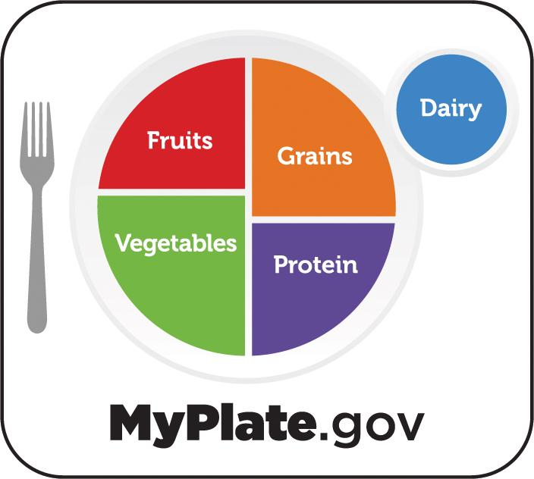
EAT AND DRINK NUTRITIOUSLY
United States Department of Agriculture
Notes:
Healthy eating involves taking control of how much and what types of food you eat.
Think of food as energy to charge up your battery for the day.
You use energy from the battery to think and move, so you need to eat regularly to keep powered up.
Your body needs certain types of food to charge its battery. These are called “nutrients.”
The types of food with the most nutrients are
Fruits and vegetables
Whole grains
Protein, especially eggs, beans, nuts, and lean meat like chicken, turkey and seafood
Avoid foods and drinks that don’t give you lots of nutrients. These include soda/pop, energy drinks, pizza, fast food, candy, and fried foods.

Slide 7
MOVE AND EXERCISE
Photo by Aaron James on Unsplash
Notes:
Being physically active doesn’t mean you have to do boring exercise routines or take up yoga.
Anything that gets your body moving is good for you! These can be simple things you enjoy like shooting hoops, playing horseshoes, dancing, riding your bike, or even just walking.
You can also be active through daily activities, like doing home projects, gardening, and cleaning your house. Any movement adds up!
You should try to move for at least 60 minutes a day. Here’s one easy way to do that:
Play chase with your dog for 15 minutes
Ride your bike for 30 minutes
Pull the weeds for 15 minutes

Slide 8
MAINTAIN HEALTHY RELATIONSHIPS
Photo by Toa Heftiba on Unsplash
Notes:
Wait – hanging out with people is part of being healthy?
It sounds odd, but it is! Remember, being healthy is about feeling good physically, mentally, and socially
More and more research shows that having strong relationships is as important to our health as everything else we’re talking about. That’s why they call good relationships “healthy” relationships”
This one is pretty easy to understand, but it makes a difference when you see people in person versus communicating on your phone or computer.
Try to hang out with friends, family, and others who are good for you in-person as much as possible.
As a bonus, get some movement in when you meet up with your friends, or get some healthy food together. That way you can help each other out!

Slide 9
GET ENOUGH SLEEP
Photo by Tania Mousinho on Unsplash
Notes:
Believe it or not, getting a good night’s sleep is probably the easiest way to improve your health – yet many people don’t do this
Most teenagers need between 7 and 10 hours of sleep a night
If you’re not getting this much, you need to make sure you allow enough time in your schedule to be in bed at least 7 hours
Try to go to bed around the same time every day, even weekends, and wake up at the same time
Make sure your bedroom is dark and cool. That tells your body that it’s time to sleep.
It’s very important to not look at electronic screens (computers, smartphones, TVs) before you go to bed. These emit lights that stimulate your brain and make it harder to fall asleep.

Slide 10
HOW CAN I BECOME HEALTHIER?
DAY: Monday, May 1, 2023
EAT AND DRINK NUTRITIOUSLY | Checks: 1
◻ Eat three or more servings of vegetables ◻ Don’t drink beverages with added sugar (soda, energy drinks, etc.) ◻ Drink eight glasses or more of water ◻ Sit down and focus on your food when eating. Don’t eat when driving, walking, or doing other activities ◻ Eat fruit, nuts, or vegetables as snacks rather than processed food (chips, candy bars, cookies, etc.) ◻ Eat breakfast within two hours of waking up ◻ Prepare one meal from fresh foods ◻ Don’t add sugar, honey, or other sweeteners to your food and drinks
DAY: Monday, May 29, 2023
EAT AND DRINK NUTRITIOUSLY | Checks: 3
◻ Eat three or more servings of vegetables ◻ Don’t drink beverages with added sugar (soda, energy drinks, etc.) ◻ Drink eight glasses or more of water ◻ Sit down and focus on your food when eating. Don’t eat when driving, walking, or doing other activities ◻ Eat fruit, nuts, or vegetables as snacks rather than processed food (chips, candy bars, cookies, etc.) ◻ Eat breakfast within two hours of waking up ◻ Prepare one meal from fresh foods ◻ Don’t add sugar, honey, or other sweeteners to your food and drinks
Notes:
You’re going to use a daily health habits checklist to keep track of your health habits for a month. Your 4-H leader will discuss this with you. You don’t need to do everything on these checklists. You just need to make progress.
This slide shows someone who improved by two checkmarks over four weeks. That’s all you need – progress!
Some tips:
Make changes slowly. Do not expect to change your eating or activity habits overnight. Changing too much too fast can hurt your chances of success.
Look at ways you can make your eating and physical activity habits healthier. Using this checklist for a week or two will help you see which habits you can change and help you choose one. Do you skip breakfast? Do you drink soda everyday?
Use the checklist to set a few realistic goals for yourself. If you drink soda everyday, try drinking water or juice instead of soda every other day. Once you are routinely drinking less soda, try cutting out all soda. Then, move on to another goal.
Get an accountability buddy at school or someone at home to support your new habits. Ask a friend, sibling, parent, or guardian to help you make changes and stick with your new habits.

